Slide 1


Slide 2
POND’S FOUNDED
The Pond’s skincare brand was founded in 1846 by American pharmacist Theron T. Pond in New York City. Pond’s is considered the oldest face care brand still in existence today. In 1886, Pond’s began to advertise nationally. They advertised under the name of Pond’s Healing until 1910.
Today Pond’s is sold around the world. Its largest markets are in Spain and in Asia, including India, Japan and Thailand.

Slide 3
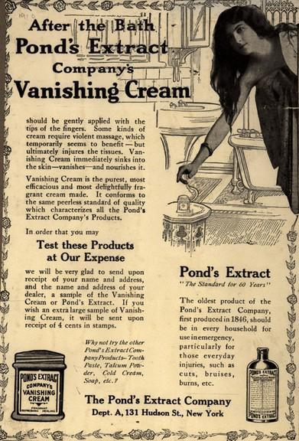
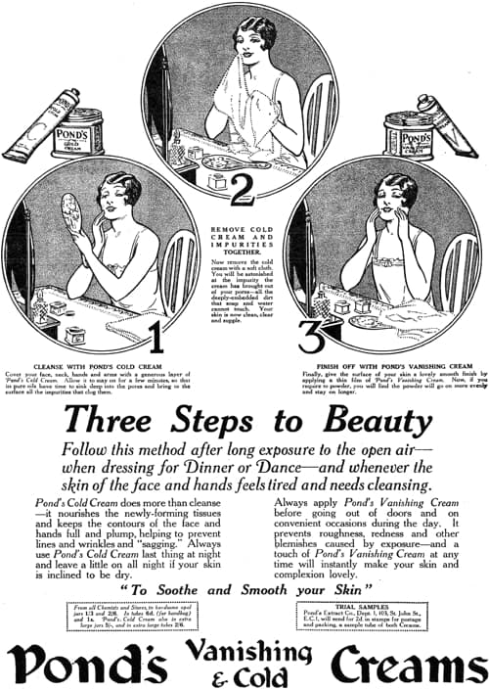

Slide 4
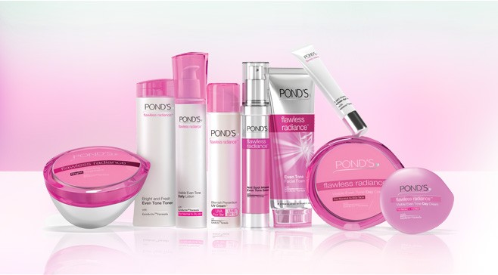
POND’S PRODUCTS LIST
1. Dry Skin Cream 2. Moisturizing Cream 3. Nourishing Moisturizer 4. Age Miracle Cream 5. Flawless White Cream 6. Pimple Clear Face Cream 7. Soft & Silky Body Lotion 8. Nourishing Body Lotion 9. Intensive Moisturizing Body Lotion 10. Pure White Face Wash 11. Pimple Clear Face Wash 12. Gentle Exfoliating Face Wash 13. Pimple Clear Spotless Face Wash 14. Pimple Clear Spot Treatment 15. Age Miracle Day Cream 16. Age Miracle Night Cream 17. Sun Protect Non-Greasy Sunscreen 18. Sun Protect Lip Balm 19. Gentle Exfoliating Scrub 20. Intensive Exfoliating Scrub 21. Pure White Face Mask 22. Nourishing Face Mask 23. Men’s Shaving Cream 24. Men’s Aftershave Lotion Please note that this list may not be exhaustive, and Ponds may have additional products or variations depending on the region or country.

Slide 5
COMPETETION OF POND’S
Johnson & Johnson
Cavinkare
Godrej
L’Oreal
.Garnier

Slide 6


Slide 7
POND’S STRENGTH
The brand appeals to the masses, particularly women, with a strong emphasis on mass appeal in its marketing campaigns. Some of the key strengths of Ponds include: Mass Appeal and Target Market: Ponds has successfully established a strong market presence and a focused target market on women.

Slide 8
POND’S WEAKNESS
Incremental increase in costs – One of the major problems facing Ponds as a brand is the incremental increase over the years in costs for the brand for transportation, labour as well as other distribution and operation costs. This naturally affects the bottom line of the product.

Slide 9
POND’S OPPORTUNITY
Increased penetration – An increased penetration is the major challenge in front of Ponds because the brand has found increased penetration in Urban areas but poor penetration in rural. To increase the same, it needs to improve awareness, a challenge being faced by all FMCG brands. Market and Expansion potential – Not only Indian FMCG market, the market expansion potential of International markets is fantastic because Skin care as a market is going to expand more and more as many countries globally are improving in their economy. Where developed markets are becoming saturated, developing economies are opportunities for companies.

Slide 10
POND’S THREATS
Competition – A Major threat for any Skin care brand currently is Competition which is so high that each of the brand has to defend its core strength and attack the others weaknesses. Ponds is no different and is vulnerable in its core strength which is Powder – where it is being attacked by Shower to Shower, Cinthol, Yardley, Nivea and several other brands.

Slide 11

POND’S ADVERTISEMENT

Slide 12
MARKETING STRATEGY
Market Development Strategy. … Product Development Strategy. … Diversification Strategy
Market Penetration Strategy.

Slide 13
REASON FOR SUCCESS
Consistent Quality. Constantly Improving. Changing with times. Latest technologies Unique fragrances.

Slide 14
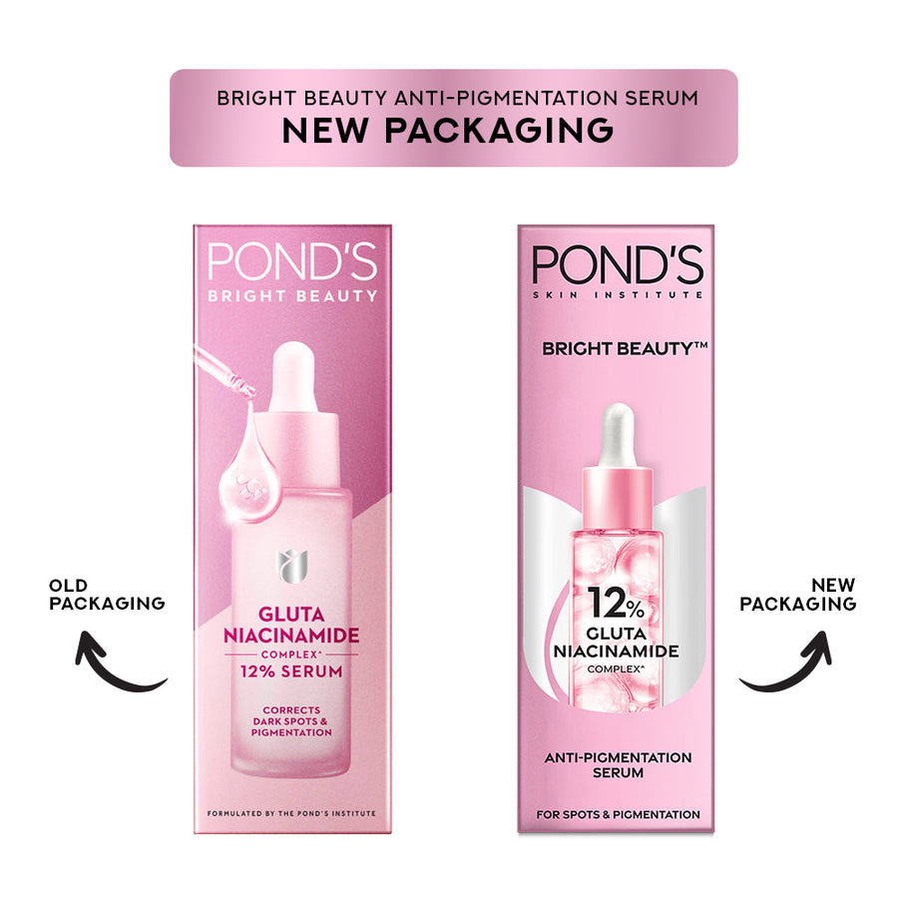
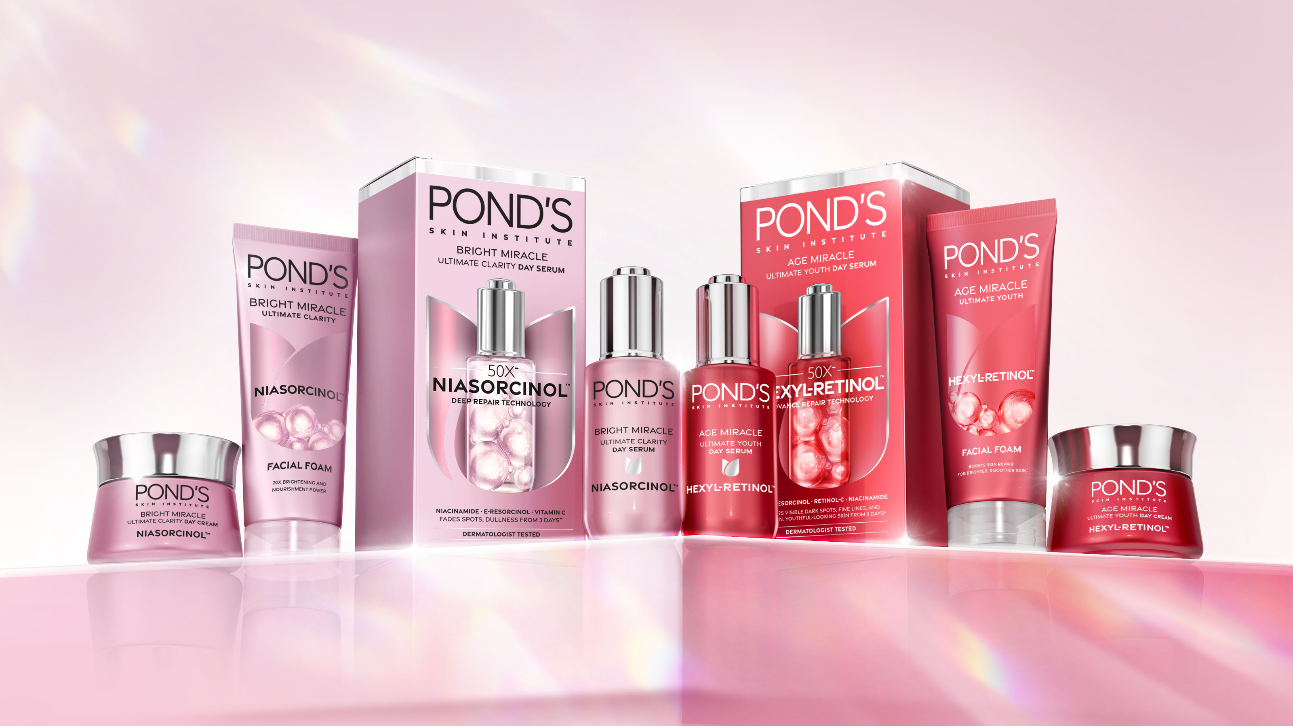
POND’S PACKAGE STRATEGY

Slide 15
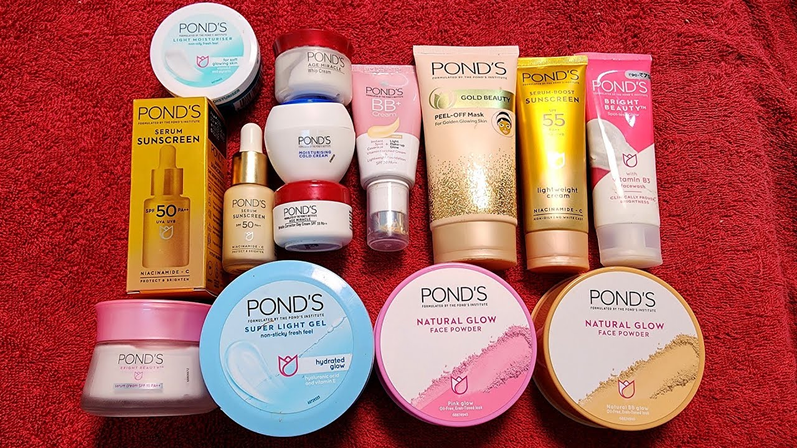
POND’S PRODUCTS

Slide 16
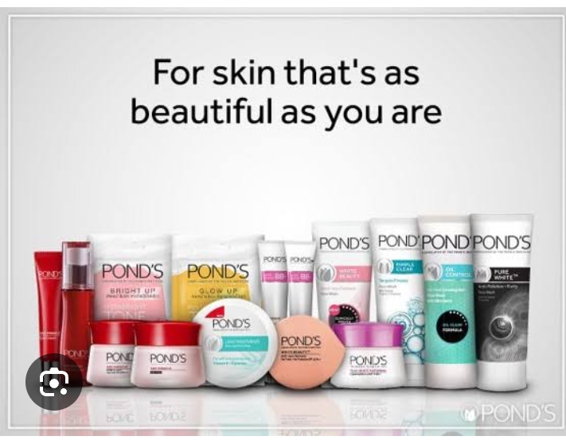

Slide 17
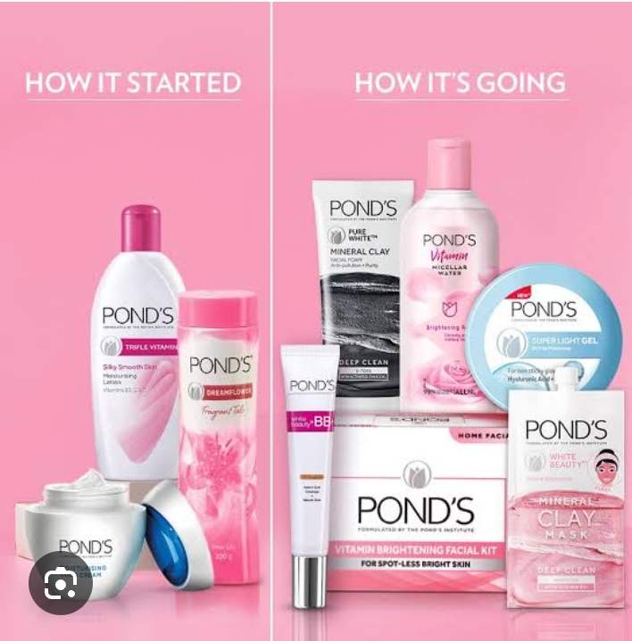

Slide 18


